Slide 1
E/LA and Math Readiness
Assessments Tutorial
November 2014

Slide 2
Readiness Form Items

Slide 3
Acuity Readiness Form Item Types
Content | Item Type | Student Action
ELA/Math | Multiple-Choice (MC) | Single correct response
ELA/Math | Multiple Correct Response (MCR) | Multiple option, multiple choice
ELA/Math | Drag-and-Drop (DD) | Drag and drop single or multiple elements
ELA | Evidence-Based Selected Response (EBSR) | Two parts with multiple choice
Math | Equation/numeric | Enter equation or numeric response
Notes:
3

Slide 4
Technology-Enhanced Items
Elicit a response from the student (e.g., selecting one or more points on a graphic, dragging and dropping a graphic from one location to another,
manipulating a graph).
Employ technology to assess content, cognitive complexity, and Depth of Knowledge not assessable otherwise.
The ultimate goal of TE items is to provide better measurement of student knowledge and skills through technology.

Slide 5
ELA: Multiple Correct Response
Select the two sentences from the story that show how the narrator feels about the setting.
An alley ran along the back of our house.
Kids prowled about seeking adventures.
The alley was a place where adventures could be found.
It was a fine place . . .
“It is a horrible place!”
There was nothing to see there.
Note: An MCR format may also be used as Part B on an EBSR item.

Slide 6
ELA: Evidence-Based Selected Response (EBSR)
What does the word “swayed” mean in paragraph 1?
A remained still
B slowly began to die
C grew taller than expected
D gently moved back and forth
Part B
What detail in paragraph 1 best supports the answer to Part A?
A “…along the back of our house…”
B “…weren’t found anywhere else…”
C “The grass was high…”
D “…even with only the tiniest of breezes.”

Slide 7
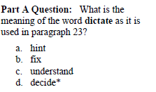
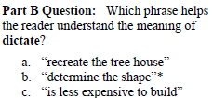
ELA: Evidence-Based Selected Response (EBSR)

Slide 8
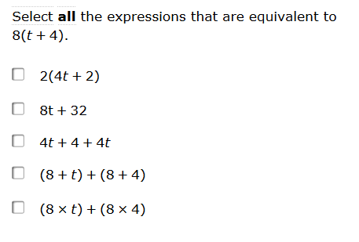
Math: Multiple Select

Slide 9
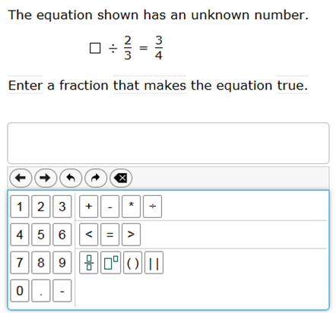
Math: Numeric Response or Equation Entry

Slide 10
Online Reports

Slide 11
Readiness Assessments Tips
Stay focused on the academic standards performance. In particular, standards covered by instruction or where the expectation is students should “be proficient”. Student and Class Assessment reports for example can provide more actionable learning data than a Roster report.
Readiness assessments will be a mix of new Acuity multiple-choice and technology-enhanced items. These new items have been built to support College and Career Ready standards. Students may find these items more challenging and may need more time to choose an answer.
Keep in mind the items on Readiness 1,2, and 3 are all on grade level. It’s quite possible students will see items aligned to the new standards not yet covered in class. Share this with students so they will not be discouraged or think the assessment is “too hard”.
As students move from Readiness 1 to Readiness 2-3 forms they will most likely see more TE items. This may mean additional time to complete an assessment.

Slide 12
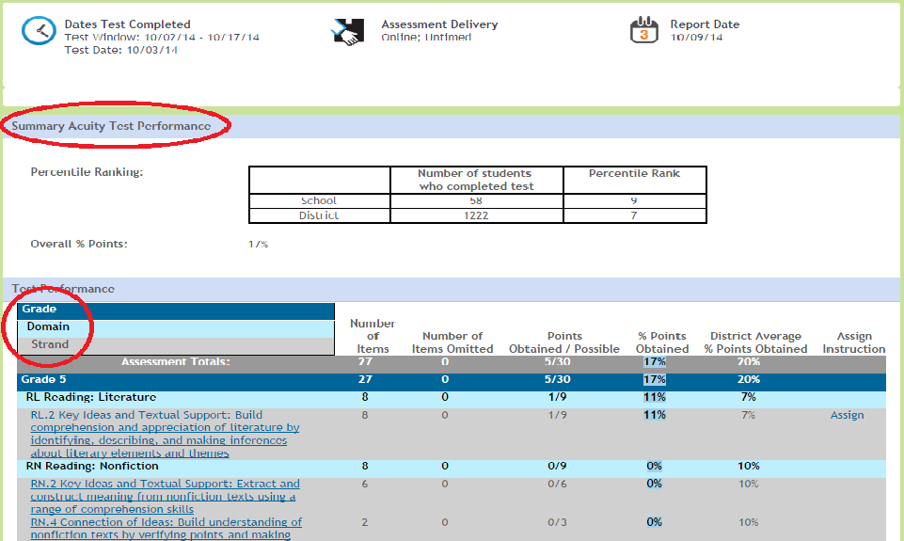
Student Assessment Report
Notes:
Sample Student Readiness Assessment Report.
Provides individual learning data by subject, grade, standard, and reporting category. If instruction is available an “Assign” link is offered under “Assign Instruction”.
12

Slide 13
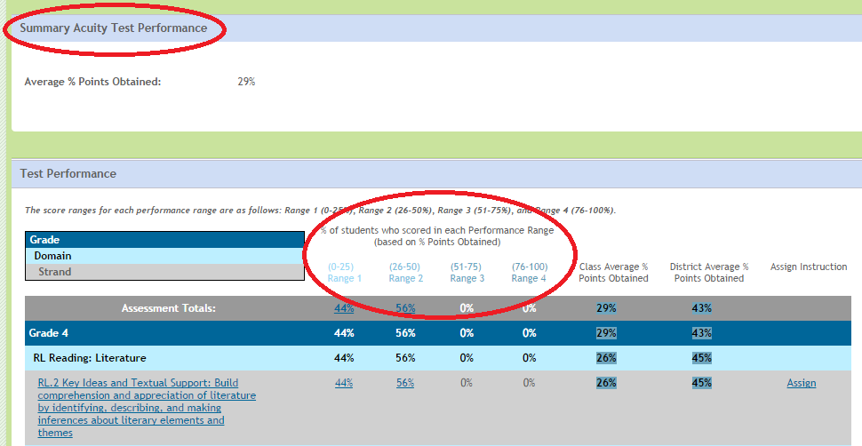
Class Assessment Report
Notes:
Sample Class Readiness Assessment Report.
Provides classroom learning data by subject, grade, standard, and reporting category. Performance Ranges are also introduced. If instruction is available an “Assign” link is offered under “Assign Instruction”.
13

Slide 14
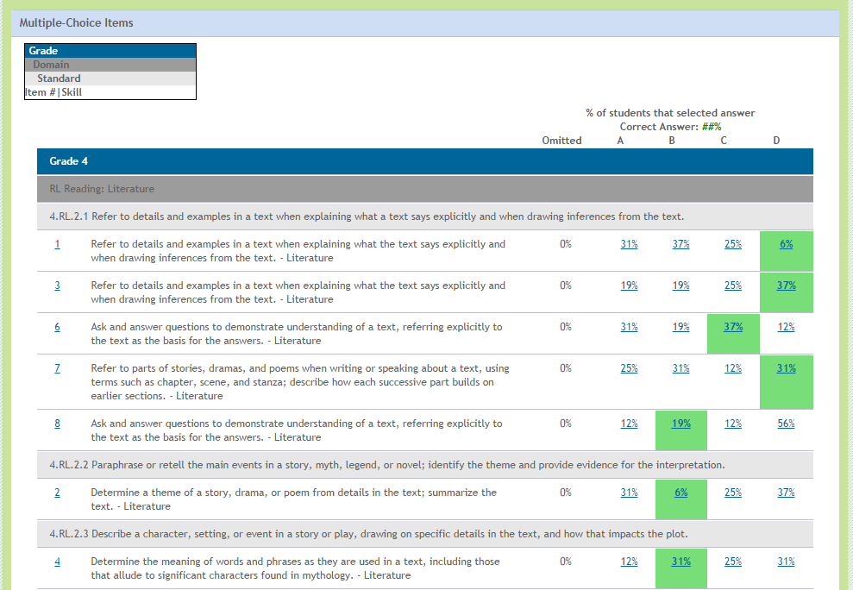
Class Item Analysis Report
Notes:
Sample Class Item Analysis Report.
Provides classroom learning data by subject, grade, standard, and reporting category. Note on the left items are underlined and may be viewed. Green highlights show the correct answer and class percentage breakdowns.
14

Slide 15
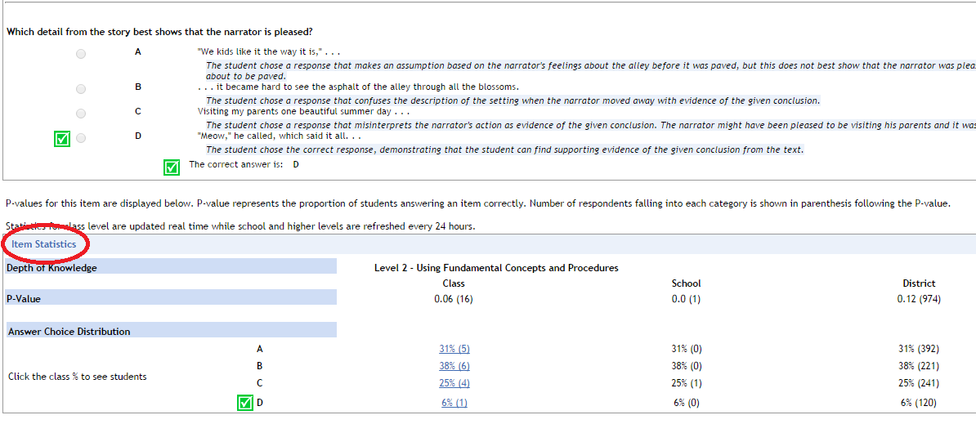
Item View
Notes:
Sample Item View.
This Item View screen provides the question, distractors, correct answer, P-value, and answer choice distribution.

Slide 16
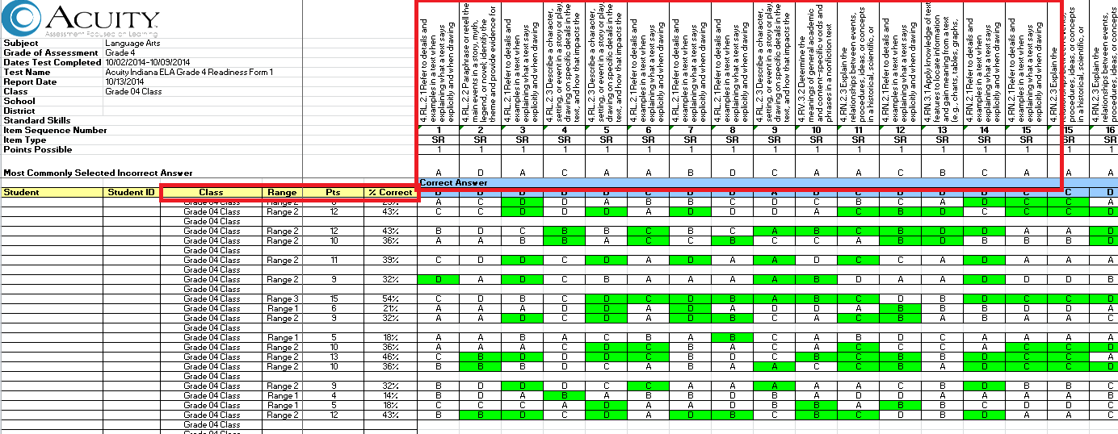
Classroom Matrix
Notes:
Sample Classroom Matrix Report.
Downloadable worksheet (Excel) shows range, % correct, and individual answers by indicator. In essence it combines data from the Assessment and Item Analysis reports into a downloadable Excel file. On the left side notice the header information available. On the upper right notice the indicators, item numbers, and answer choices as you move across in the spreadsheet.

Slide 17
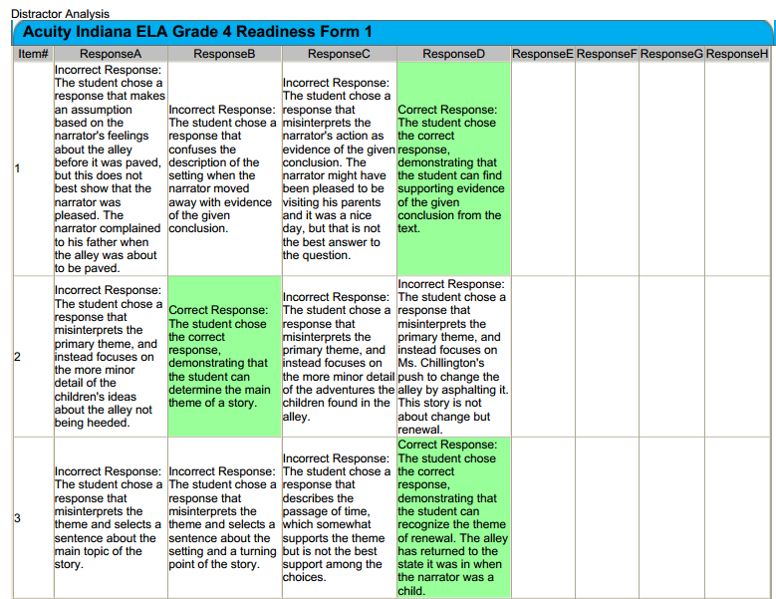
Distractor Analysis
Notes:
Sample Distractor Analysis.
Offers additional insight on why a student may have incorrectly answered an assessment item.
17

Slide 18
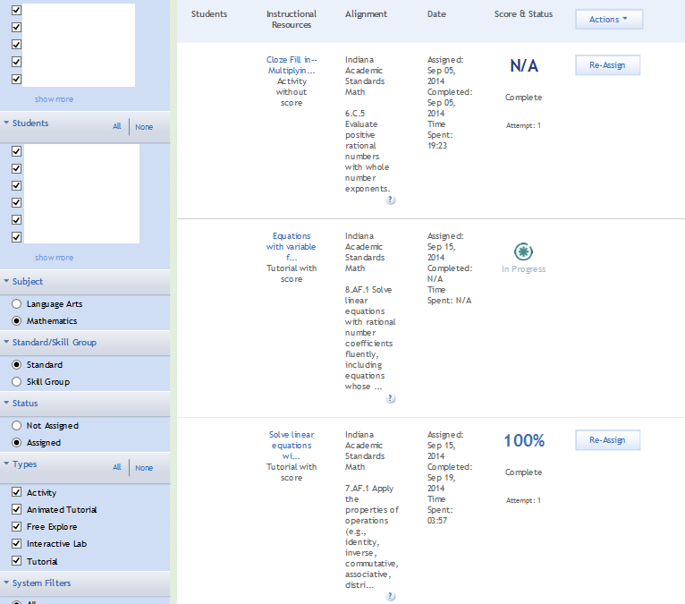
Student Learning Support Report
Notes:
Sample Learning Support Report.
Can provide important instructional resource information including assignment date, score, and status.
18

Slide 19
Support Resources

Slide 20
IDOE Acuity Digital Library
Requires Acuity Username and Password
Notes:
SU eTollkit
School Admin eToolkit
update Tech Specs

Slide 21
Acuity Online Support Resources
Acuity Community
Acuity Help
Notes:
Screen shot of New UI and online resources.

Slide 22
Acuity Online Support Resources

Slide 23
Acuity Readiness Maps

Slide 24
Formative Assessment

Slide 25
Formative Assessment
“Formative assessment is central to good instruction in several ways, including focusing learning activities on key goals; providing students feedback .… and providing teachers with systematic information about student learning to guide future instruction and improve achievement. Yet teachers typically have little preparation in assessment or how to use such information well.” (Anne Lewis, 2005 CRESST Conference)
Notes:
25
25

Slide 26
Acuity And Formative Assessment
Acuity learning activities provide evidence of student learning. Acuity learning data can be used in conjunction with other types of evidence to adjust instruction or provide feedback to students (and parents) about what the student needs to do next to meet State learning targets.
Notes:
26
26

Slide 27
Acuity Formative Assessment Activities
InFormative Report Data Reviews
Item Review/Distractor Analysis
ELA/Math Instructional Resources
Custom Tests
Performance Assessments (optional)
Formative Assessment Plan (document)
Notes:
27
27

